Slide 1
RYNIXSOFT HYBRID INTERNSHIP WEEK 4
BY
SWETHASUPRIYA AS

Slide 2
Sprint 4 – Prototyping & UX Case Study
Create interactive clickable prototype
Conduct basic usability validation
Document full UX case study
Explain design decisions & iterations
Submit final design link

Slide 3
Interactive Prototype
Created key screens such as:
Login page
Dashboard
Task page
Admin panel
Added clickable interactions so users can navigate between screens easily.
Maintained a consistent design using a blue and white color theme for a clean and professional look, and used Poppins font for better readability.”

Slide 4
User Flow & Usability Testing
Login → Dashboard → Task Page → Admin Panel
This ensures easy and intuitive navigation.
Basic usability testing is conducted with 2 to 3 users.
Feedback is collected based on:
Ease of navigation
Clarity of the interface

Slide 5
Design Decisions & Iterations
Several design decisions are made to improve usability:
A simple layout is used for easy understanding
Blue color is chosen to provide a professional look
Clear buttons are designed for better interaction
Based on user feedback, improvements are made such as:
Enhancing button visibility
Simplifying the dashboard layout
Improving spacing and alignment

Slide 6
UX Case Study & Final Output
The complete UX case study is documented, including:
Problem statement
User needs
Solution approach
The final interactive prototype is completed and refined based on feedback.
The design link is submitted through Figma.
This sprint highlights how structured design and usability improvements enhance user experience.

Slide 7
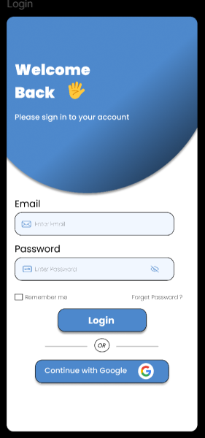
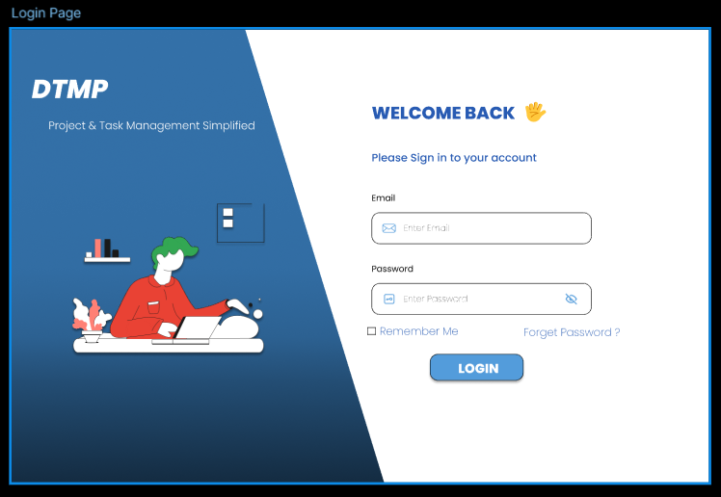
Login Page

Slide 8
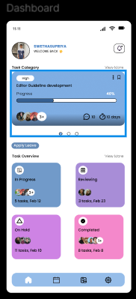
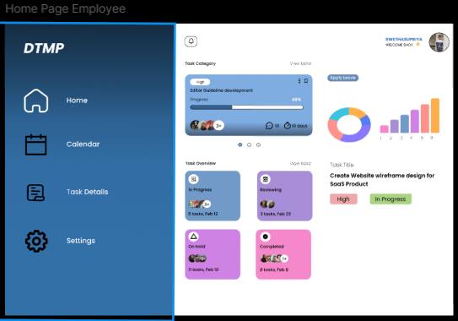
Dashboard

Slide 9
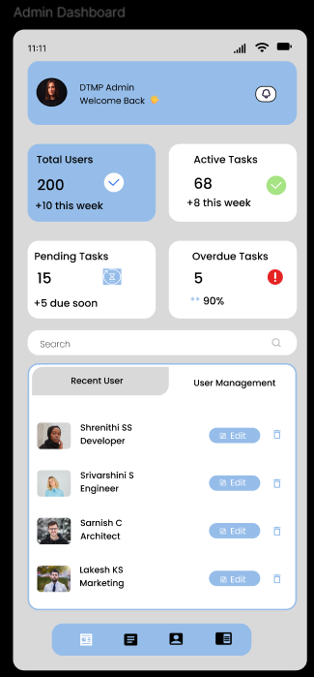
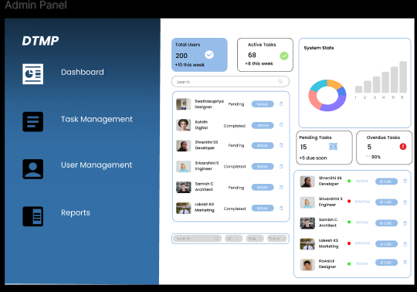
Admin Panel

Slide 10
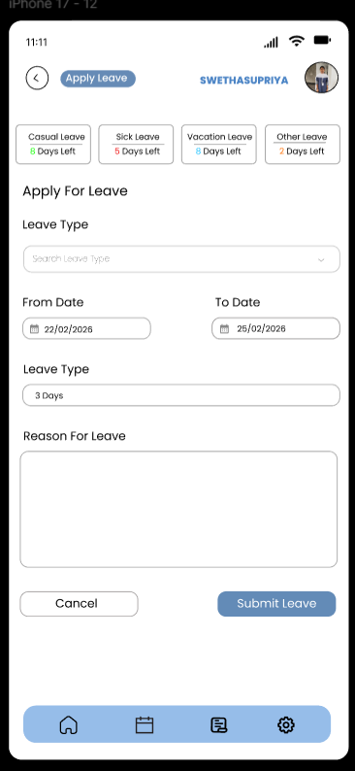
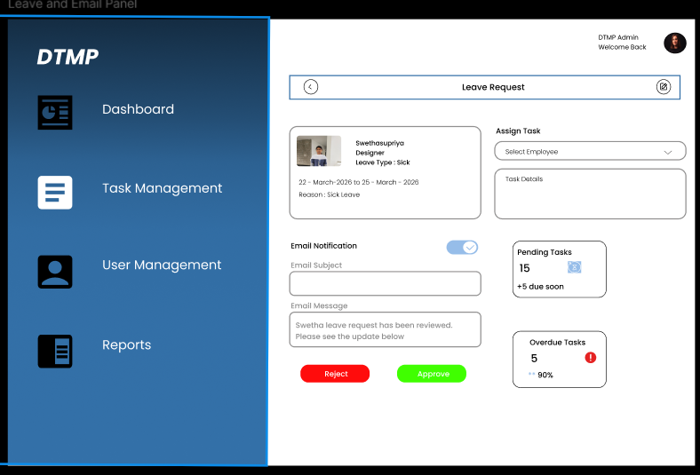
Leave Request and Approve Page

Slide 11


